Slide 1
Strategic Plan Update
DRAFT
Betsy Beise, Associate Provost for Academic Planning & Programs
On behalf of Flagship 2020 Work Group 1
Feb 11, 2016

Slide 2
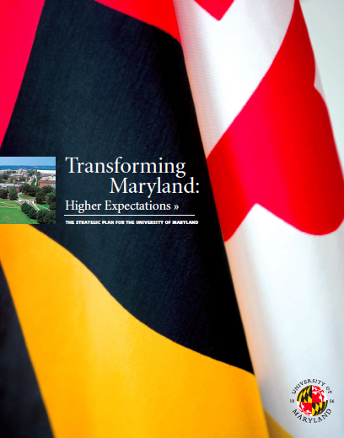
http://www.umd.edu/strat_plan/stratplan.cfm

Slide 3
Strategic Plan Update — Workgroup Members
CHAIR: Mary Ann Rankin, Senior Vice President and Provost
Kevin Anderson, Director of Athletics
Elizabeth J. Beise, Associate Provost, Academic Planning and Programs
Jane Clark, Dean, School of Public Health
David Cronrath, Dean, School of Architecture
Lucy Dalglish, Dean, Philip Merrill College of Journalism
Eric Denna, Vice President, Information Technology and Chief Information Officer
Jennifer J. Preece, Professor and former Dean, College of Information Studies
Robert Orr, Dean, School of Public Policy
Bonnie Thornton Dill, Dean, College of Arts and Humanities
Pat O’Shea, Vice President and Chief Research Officer
Kumea Shorter-Gooden, Chief Diversity Officer
Cheng-i Wei, Dean, College of Agriculture and Natural Resources
Donna Wiseman, Dean, College of Education
Robert Briber, Professor and Chair, Materials Science and Engineering
Charles Caramello, Associate Provost and Dean, the Graduate School
William Cohen, Professor of English and Associate Provost and Dean, Undergraduate Studies
Donna Hamilton, Professor of English (former Associate Provost and Dean, Undergraduate Studies)
Mary Hummel, Assistant Vice President, Student Affairs
Christopher Jarzynski, Professor, Chemistry and Biochemistry and IPST
Samir Khuller, Professor and Chair, Computer Science
Sharon La Voy, Director, Institutional Research, Planning and Assessment
Angus Murphy, Professor and Chair, Plant Sciences and Landscape Architecture
Mark Rivera, Graduate Student
Katherine Russell, Associate Dean, College of Behavioral and Social Sciences
Babak Hamidzadeh, Interim Dean of Libraries

Slide 4
Charge to the work group:
Highlight our major accomplishments among the goals set forth in the 2008 plan; assess our current strengths and challenges; restate and refine our vision and mission; identify the new opportunities in education, research, and innovation in our changing environment, taking us through 2020.
The draft is at: http://www.umd.edu/Flagship2020
A summary of process and reference materials are at: http://www.provost.umd.edu/sp15/public

Slide 5
Steps to date
March 2015: Community Vision Sessions
The Center for Leadership and Organizational Change (CLOC) held a number of focus group meetings with key stakeholder groups and four open sessions for the campus, focused on where the campus should be in 2020 and what it would take to get there.
Sept 2015: Additional feedback requested via a web survey
About 350 responses for each of five questions, very consistent messages as emerged from the focus groups.
Sept 10, 2015: Provost Rankin’s presentation to the Senate
Dec 17, 2015: Update Draft posted for the campus
Web-based feedback collected through Feb 1, 2016.

Slide 6
Next Steps
Today: discussion among University Senators
Feb 18: Open forum and Q&A with the Provost
Feb/March: Revise the draft based on comments received, add remaining sections (cost of implementation, executive summary)
Mid-March: Post for feedback, create final version
April Senate meeting: discussion and vote

Slide 7
Feedback received so far
 | Section | # responses
I. | Education | 62
II. | Research and Scholarship | 45
III. | Strategic partnership with UMB (MPower) | 18
IV. | Arts and Humanities | 36
V. | Greater College Park | 36
VI. | Equity, Diversity, Inclusion | 34
VII. | Modernizing Administrative Procedures | 38
VIII. | Athletics | 27
In addition, a handful of letters, emails, and suggestions for added text were sent directly to the President or the Provost.
A few broad themes emerged.

Slide 8
Areas that were not explicitly called out… (but that are critical to the University’s mission, so perhaps should be)
Recruitment and retention of top faculty (TTK and PTK) is key to our future.
The critical (and evolving) role of the Libraries in education, research, and scholarship.
The many important ways that students are supported outside of the classroom (living learning programs, veteran’s center, tutoring, counseling, CARE, alternative break programs, student organizations).
The vital role of staff in all aspects of the university’s mission.

Slide 9
What is already happening… (but may not be communicated widely enough)
Improving and regularizing the role & status of PTK faculty
MPowering the State – many initiatives already, not only with the UMB medical school – value to students
MLaw minor, pre-law advising, seminars, student internships, …
http://mpower.maryland.edu/#initiatives
Greater College Park and the Innovation District (see Senate presentation by Ken Ulman, Nov 10, 2015)
Our participation in the Committee on Institutional Cooperation (as a result of entry into the Big Ten)
Faculty leadership programs, sharing of best practices, shared library resources, departmental collaborations, research collaborations, ...
Big Ten Theatre Consortium
UMD will host the CIC Academic Leadership Forum April 7-9, 2016

Slide 10
The Play’s the Thing—Big Ten Theatre Consortium
CIC newsletter: 9/24/2015
University of Maryland's cast of Good Kids. Photo by John Consoli
Notes:
The second commissioned work is Baltimore by playwright Kirsten Greenidge. Consortium members will produce the play during the 2015-2016 season.

Slide 11
Where the text can be improved
“Career-readiness” is not “job-training”: meant to capture what we can do better to prepare students for their future.
How we measure the quality of our scholarship, research, and creative endeavors
Find a balance between core disciplines and new interdisciplinary initiatives
More emphasis on regional strategic advantages (not just DC)
Art & Humanities section is overly focused on the arts, needs clearer articulation of the role of the humanities

Slide 12
Back to the Senate Chair for structured comments/questions

